Slide 1

Spock: live long
(code short) and prosper
Yaroslav Yermilov

Slide 2


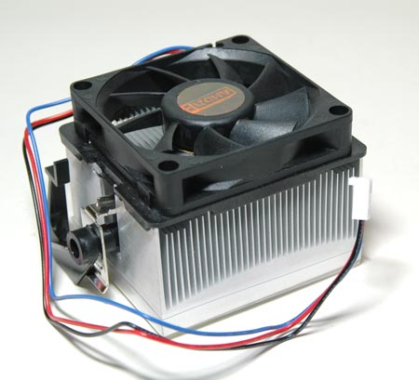

Slide 3


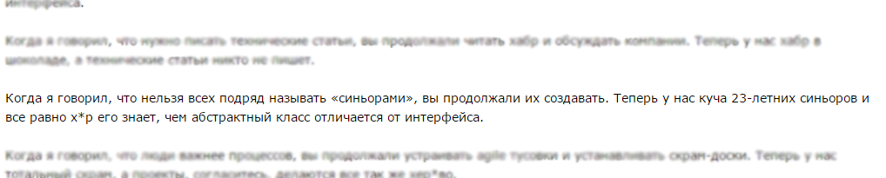
About me
Yaroslav Yermilov
Senior Software Engineer, postgraduate
https://ua.linkedin.com/pub/yaroslav-yermilov/58/682/506
https://www.facebook.com/yaroslav.yermilov
https://twitter.com/yermilov17
fond of Java, complete code, big data, data science, Groovy
http://megamozg.ru/post/7256/

Slide 4
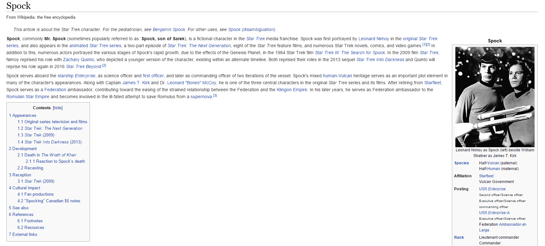
About Spock

Slide 5

What’s the problem?

Slide 6

Better to test before going to production

Slide 7
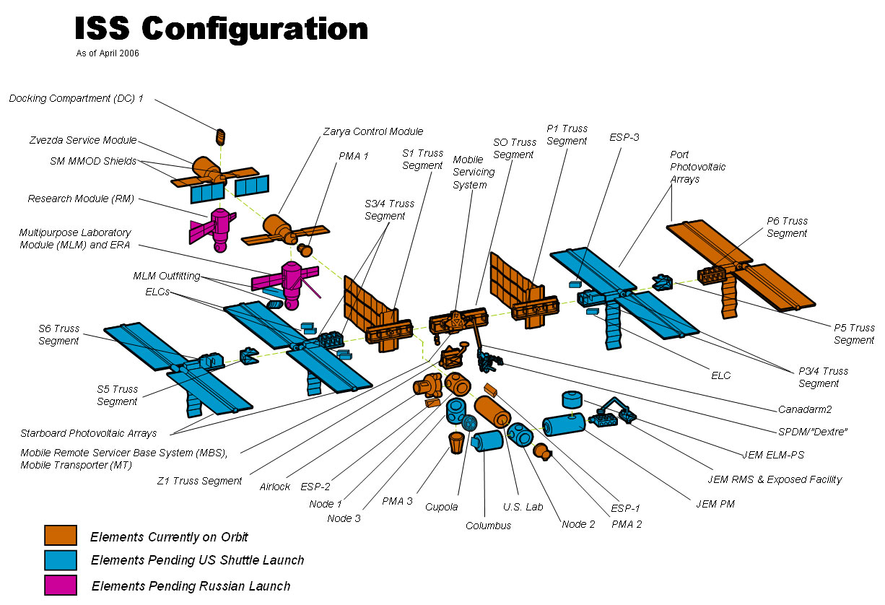
Firstly, to unit-test

Slide 8

So what?

Slide 9

JUnit?

Slide 10

JUnit on steroids?

Slide 11

Not JUnit?

Slide 12

Nothing?

Slide 13

Well, JUnit is great

Slide 14

But a little bit...

Slide 15
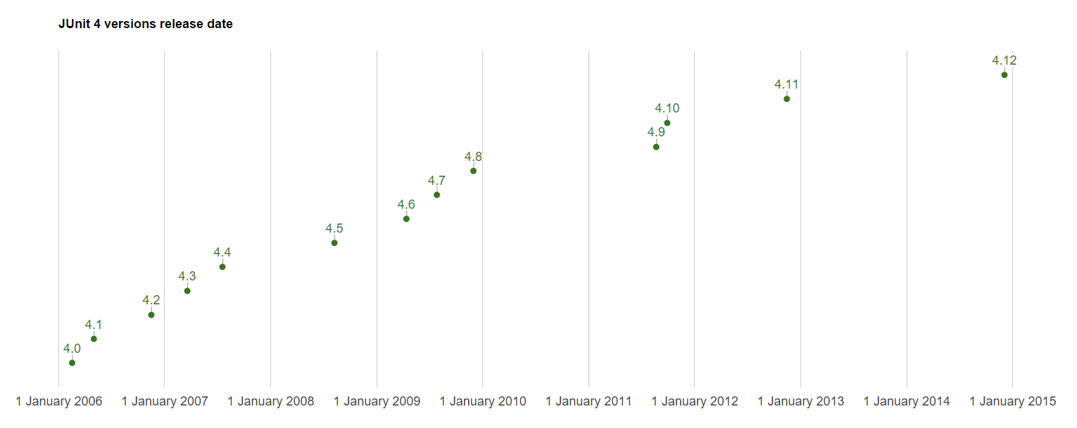
...stable?

Slide 16

So why don’t try Spock?

Slide 17
Why Groovy?
Groovy is the Java re-imagined
Have your ever think how Java 2.0 should look like?
Groovy has lots of features you even don’t think about, but after first taste you won’t be able to imagine development without them
Groovy is fully compatible with Java
Groovy has beautiful and highly expressive DSLs

Slide 18

Spock
Why Groovy?
Spock
JUnit
Groovy is the Java re-imagined
JUnit 5.0
Have your ever think how Java 2.0 should look like?
Spock
Groovy has lots of features you even don’t think about, but after first taste you won’t be able to imagine development without them
unit-testing
Spock
Groovy is fully compatible with Java
Spock
Groovy has beautiful and highly expressive DSLs

Slide 19

Spock is Enterprise ready

Slide 20

Let’s go!

Slide 21

What’s next?
http://spockframework.github.io/spock/docs/1.0/index.html
http://meetspock.appspot.com/
https://github.com/spockframework
Just use it in your projects and enjoy!

Slide 22

Thanks!

